Slide 1

FINAL GROUP PROJECT
Industry Analysis
THE POWER OF DATA ANALYTICS IN BANKING
Group 2

Slide 2

1
Evolvement of Data Analytics in Banking

Slide 3
Evolvement of Data Analytics in Banking
Customer Services Improvement
01
Risk Management
02
Internal Controls
03

Slide 4
Customer Services
Name | Dollars in bank
James | $15,446,547.00
Zhao | $17,224,783.00
Ben | $24,887,239.00
Emma | $44,214,548.00
Lydia | $84,554,982.00

Slide 5
Risk Management and Internal Controls
Range
Efficiency
01
02
03
04
Allocation
Safety

Slide 6
2
Disruption from Big Data

Slide 7
Disruption from Big Data

Slide 8
3
Future Data Analytics Trends for Changing Banking

Slide 9
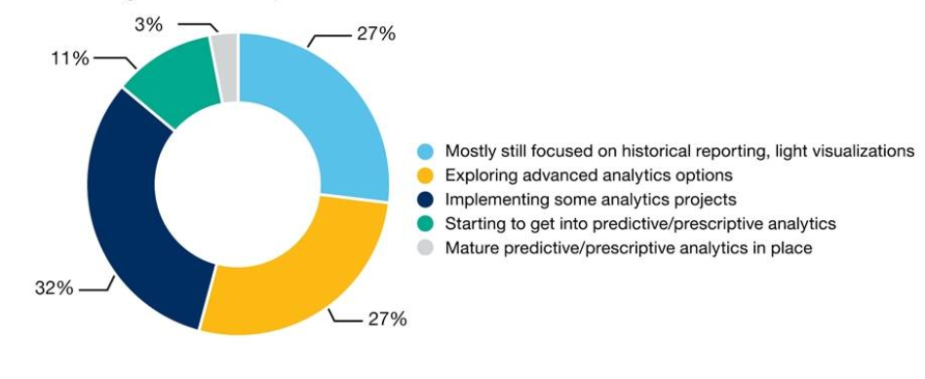
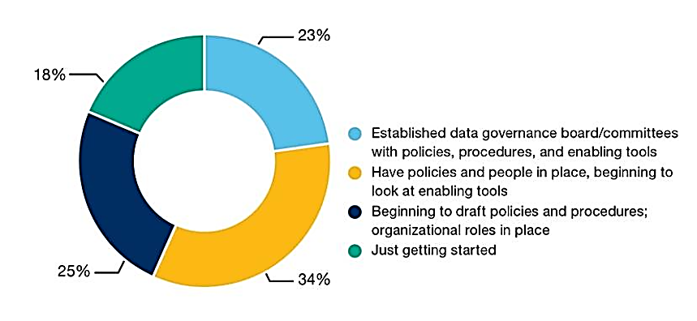
Future Data Analytics Trends for Changing Banking
Banks’ current adoption of advanced data science tools
Banks’ adoption of improved data governance practices
.

Slide 10





Future Data Analytics Trends for Changing Banking
Customer experience taking center stage
01
The use of predictive models that anticipate customer behavior and enable greater personalization and responsiveness.
.
Optimized matching mechanism
Banks can quickly analyze consumers with big data analytics and tailored to their own circumstances to match the customer's investment products, even with automatic matching.
.
02
Optimize lending decisions
Big data can analyze the borrower's reputation information and repayment ability from multiple perspectives. The entire loan process can be simplified to minutes or even seconds.
.
03

Slide 11
4
Organizational Roles into Data Analytics Within Banking

Slide 12

Organizational Roles into Data Analytics Within Banking
01
Fraud Prevention Analyst
Help customers avoid some fraud risks and eliminate abnormal expenses that customers may have
02
Credit Risk Analyst
Enable the bank to reduce the possibility of default, and let the borrower to get the loan in time.
03
Anti-Money Laundering (AML)
Prevent money from flowing to terrorist organizations and stop money laundering.
04
Customer Service Analytics
Provide better service to consumers.

Slide 13
5
The Current Demand for Data Analytics Talent

Slide 14
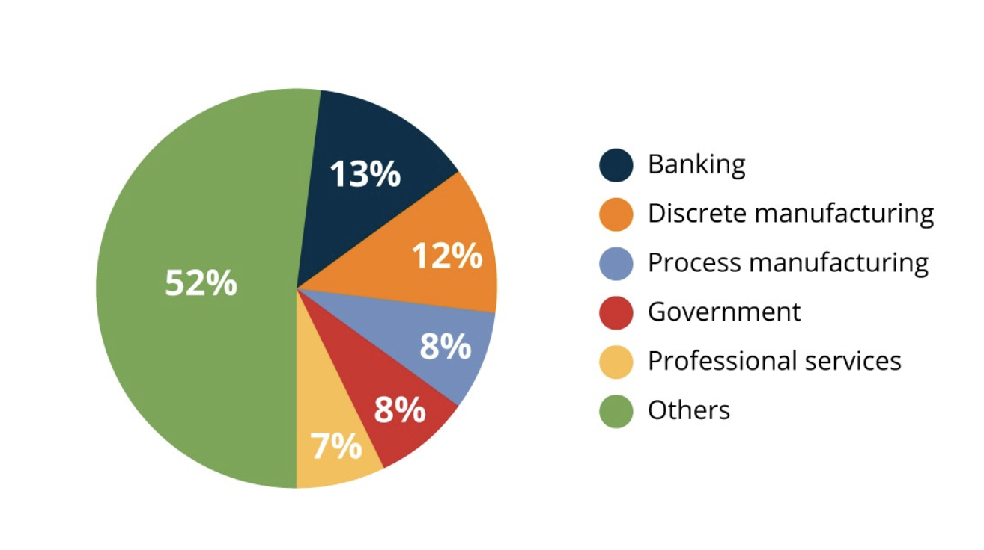
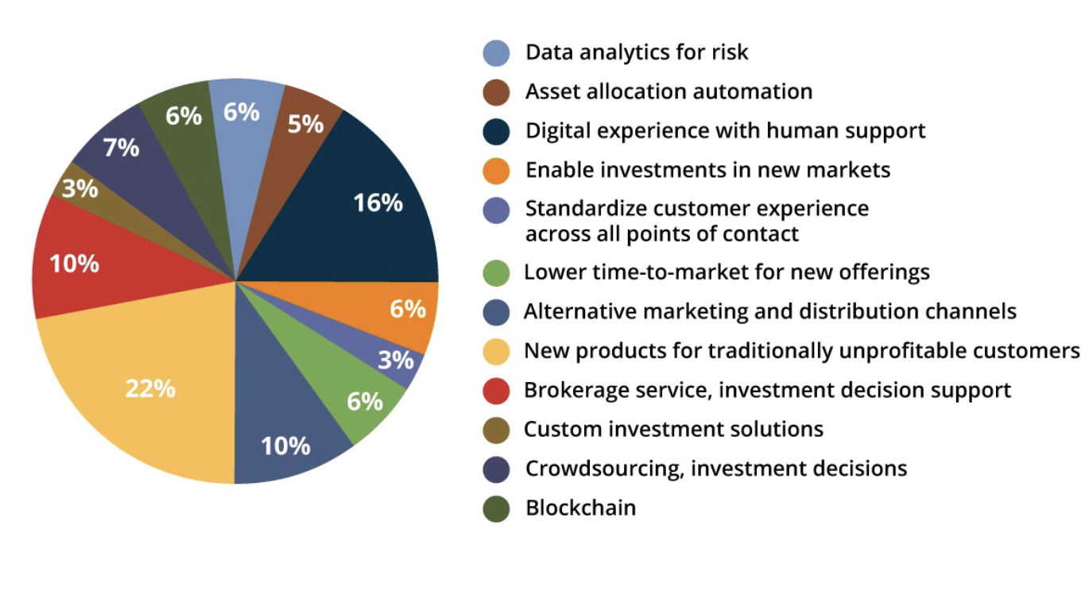
Big Data Analytics in The Banking Sector
The IDC Semiannual Big Data and Analytics Spending Guide of 2016
The allocation of funds

Slide 15
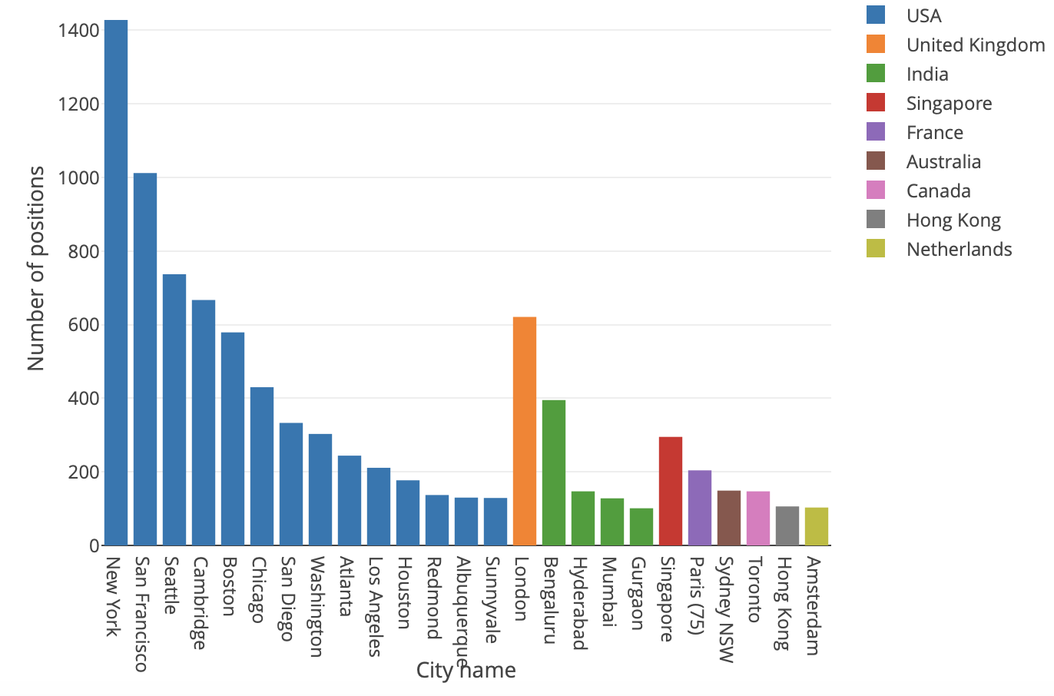
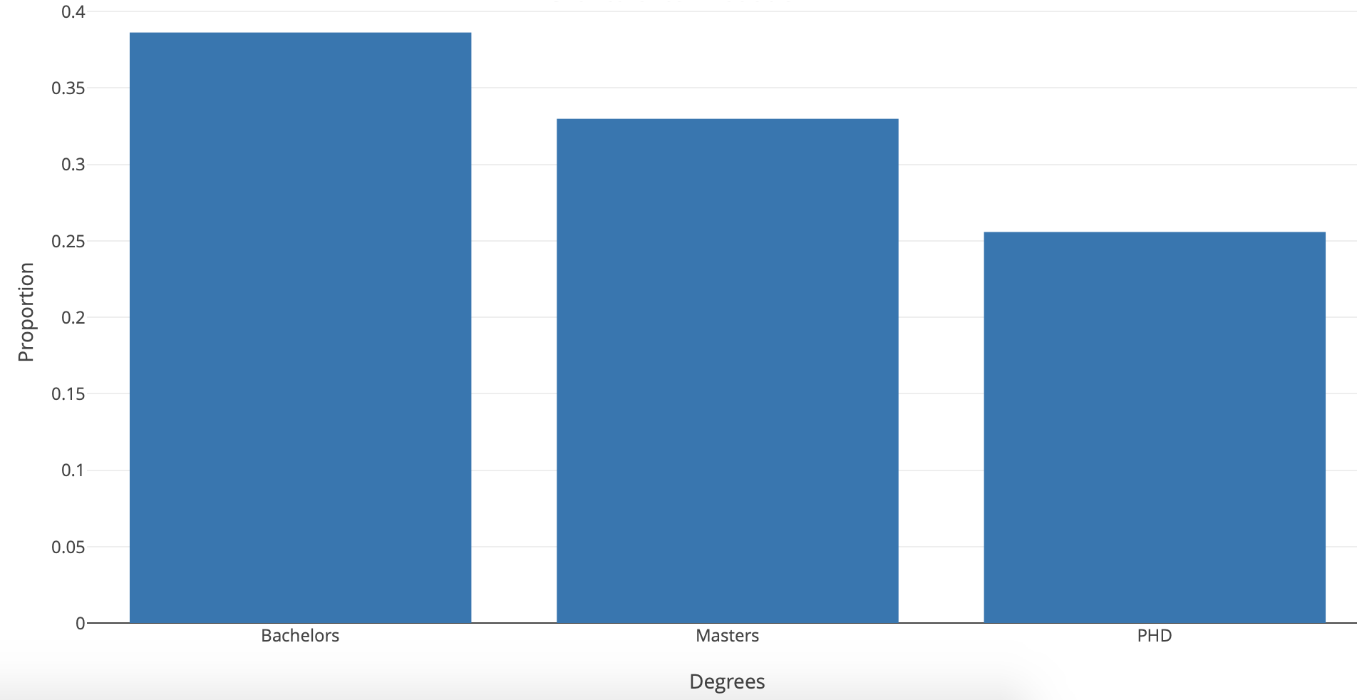
Demand for Data Science Positions and Degrees in one month in 2018
New York is the city with the highest number of postings, with over 1,400 for the past month. NYC is followed by San Francisco and Seattle in the USA, London in Europe, Bengaluru in India, and Singapore. Almost 40 percent of the job openings are interested in bachelor's degrees, almost 30 percent in master's degrees and about 25 percent in PhDs.

Slide 16
6
Ideal Career Roles and Inspiring Positions

Slide 17

Skills of A Domain Business Analyst
Business analyst
Analysis skills and techniques
Business domain knowledge
Technical domain knowledge
Interpersonal/soft skills/professionalism

Slide 18
7
Concerns and Ethical Issues in Banking

Slide 19
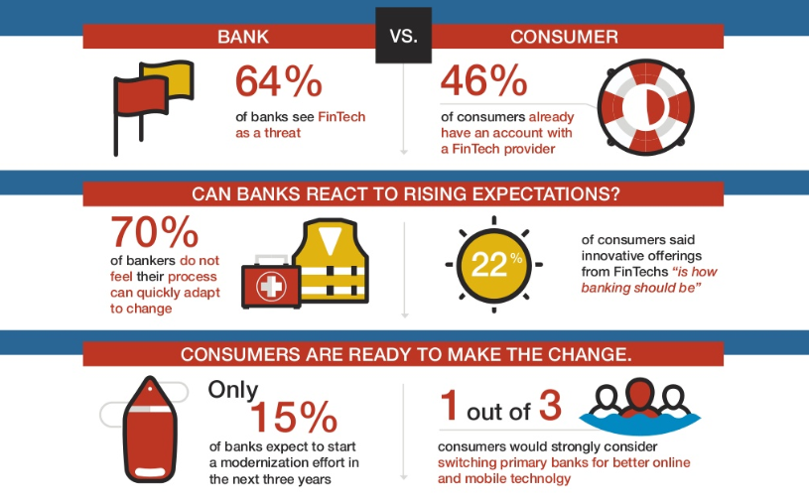
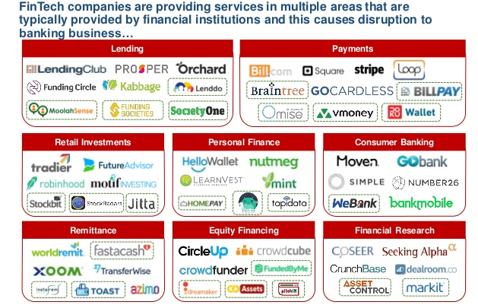
Source: NTT DATA
THE FINTECH THREAT
Blurred lines: 20% of the financial services business will be at risk from fintech by 2020, based on research with 544 respondents, principally CEOs, heads of innovation, chief information officers (CIOs) and top-tier managers involved in digital and technological transformation.

Slide 20
THE FINTECH THREAT
1. Top Fintech Trends in payments
Advanced tools and technology to protect customers from identity theft and fraud (63%)
Increased push for faster payments (52%)
Rise of digital wallet adoption (51%)
2. Fintech disruption
Consumer banking (73%)
Funds transfer and payments (55%)
Investment & Wealth Management(35%)

Slide 21
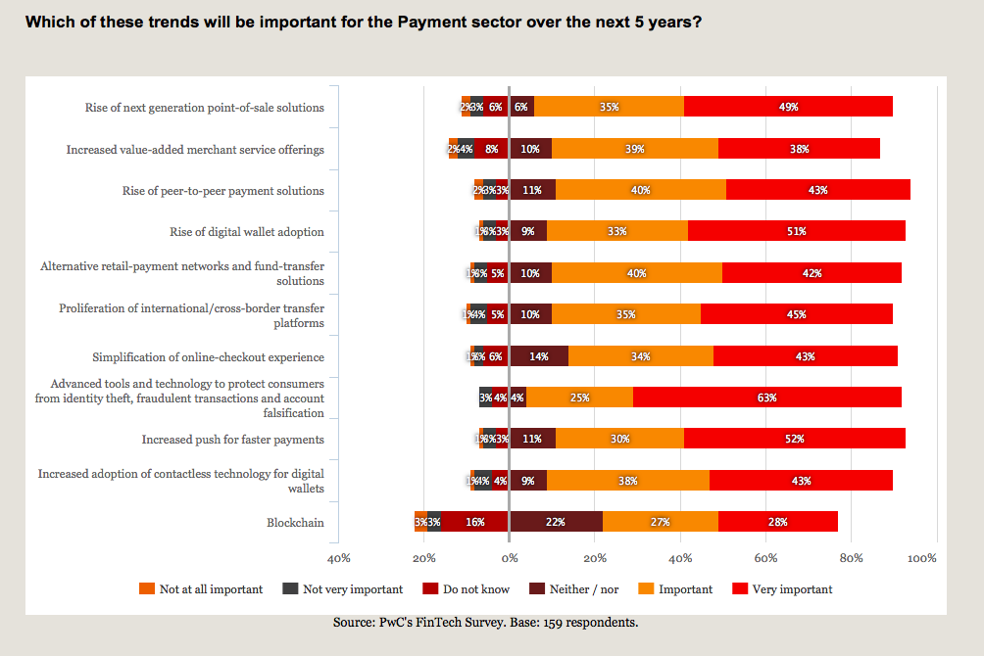

Slide 22
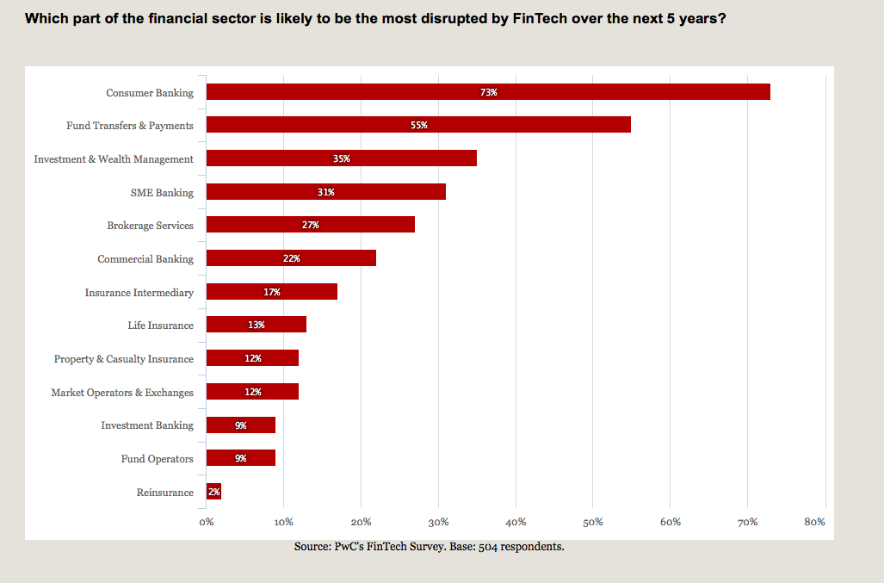

Slide 23
Biggest Threats to Banking in 2019
People’s top five frustrations with their banking providers include:
Acting in dishonest, unethical or illegal ways
Constantly slapping them with nickel and dime fees
Failing to offer competitive rates and pricing
Data breaches or exposing personal/account data
Hitting them with overdraft charges
Source: thefinancialbrand.com

Slide 24
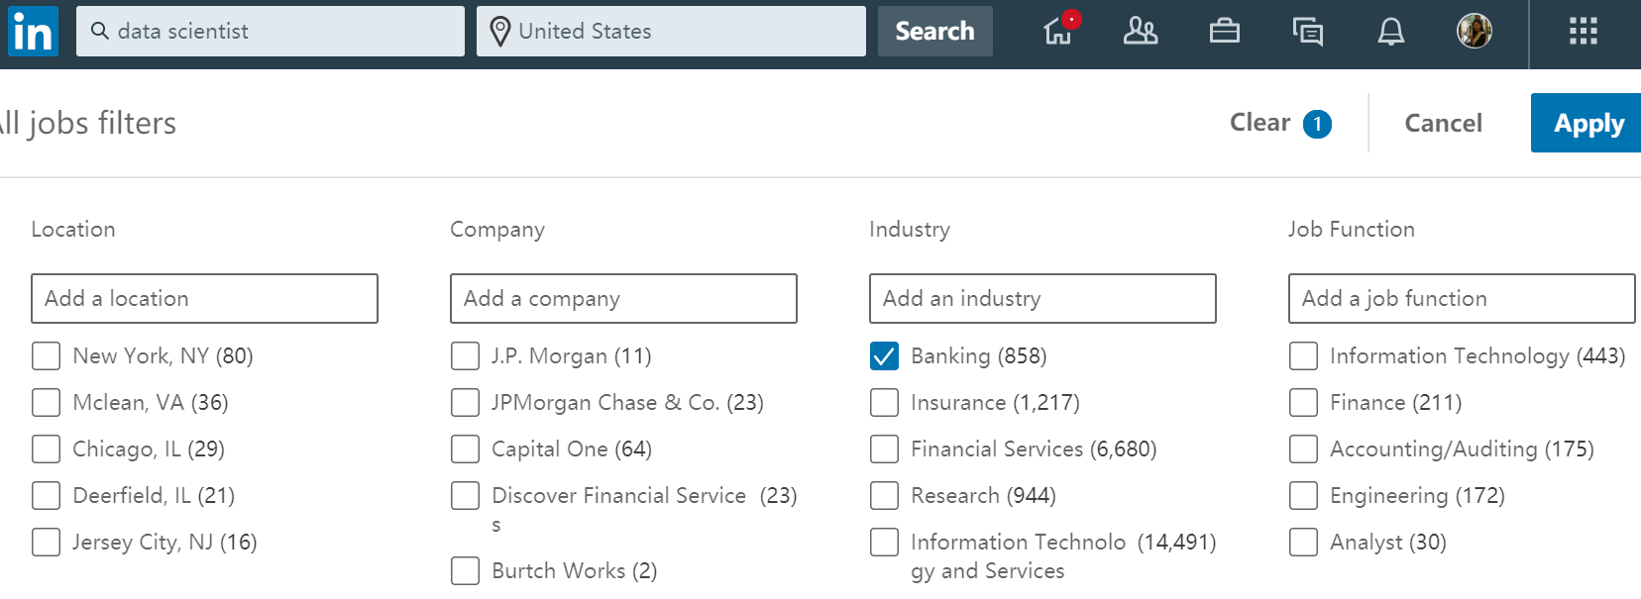
Positions in Functional Areas (Front)
Technical Support (Data Scientists)
-Risk control or customer services functional
-Routinely work & Long working hours
-High risks relatively lower income level
-Difficult to manage work life balance
-Long term career
-Fewer available positions
-Intensive working hours & High risks
-Extremely high requirements standard
-Solid technical background + financial industry experiences
-Excellent Hard & Soft skills

Slide 25
Thank You!
GROUP 2 – BANKING INDUSTRY ANALYSIS

